Slide 1


Slide 2

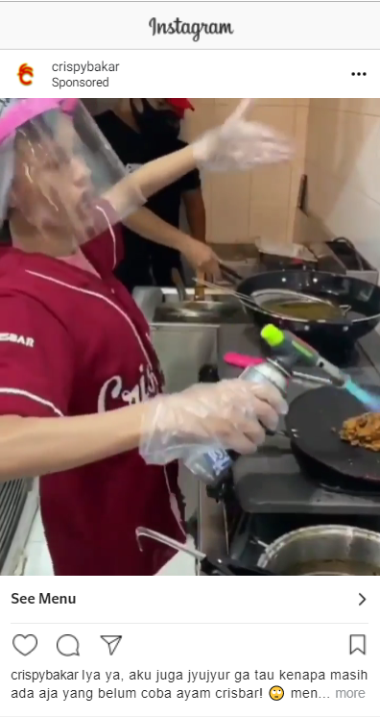
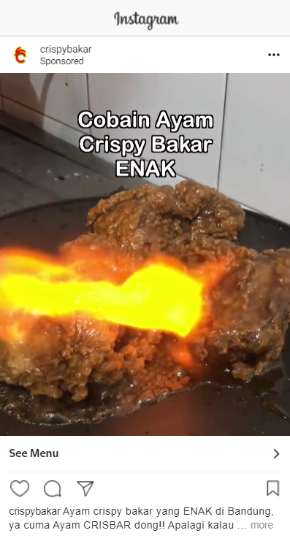
PROSPECTING CRISBAR CAMPAIGN
Lookalike 0-2%
CPR : Rp 119
Amount Spent : 1,861,231
Lookalike 0-2%
CPR : Rp 138
Amount Spent : 512,822
Lookalike 2-4%
CPR : Rp 118
Amount Spent : 197,752
Lookalike 2-4%
CPR : Rp 120
Amount Spent : 911,277
ALWI CRISBAR
ANGKY CRISBAR
SCORE : 6
RESULT : STILL RUNNING ON AUGUST
SCORE : 5
RESULT : STILL RUNNING ON AUGUST

Slide 3
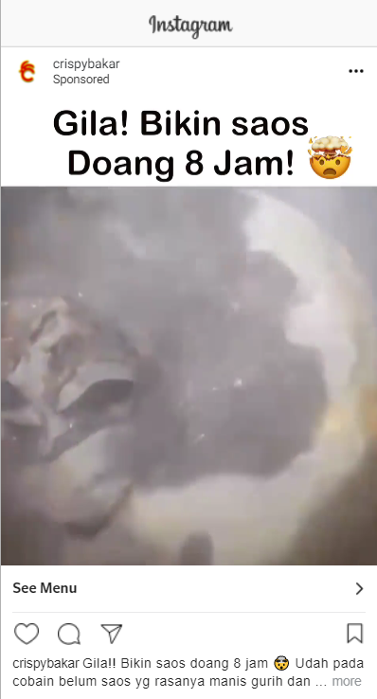
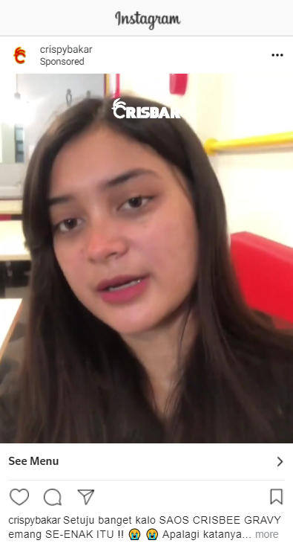
PROSPECTING CRISBEE CAMPAIGN
Lookalike 0-2%
CPR : Rp 102
Amount Spent : 2,220,605
Lookalike 0-2%
CPR : Rp 108
Amount Spent : 1,951
Lookalike 2-4%
CPR : Rp 98
Amount Spent : 944,735
Lookalike 2-4%
CPR : Rp 312
Amount Spent : 3,535
DKB CRISBEE
CRISBEE LUNET
SCORE : 9
RESULT : STILL RUNNING ON AUGUST
SCORE : 26
RESULT : TAKE OUT ON AUGUST
SUGGEST : video versi angky tan dibuat versi crisbee

Slide 4
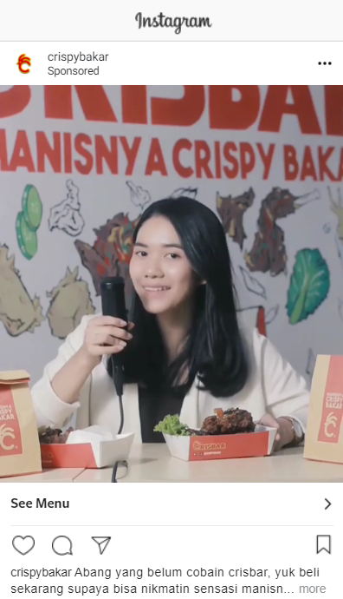
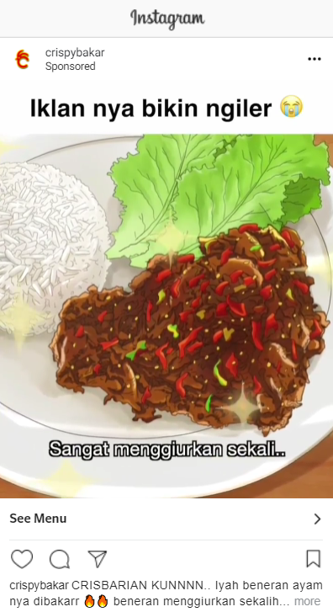
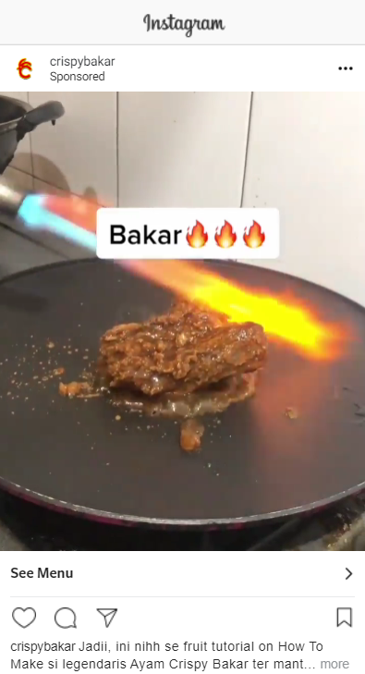
REENGAGEMENT CRISBAR CAMPAIGN
IG & FB CPR : Rp 209
Amount Spent : 151,815
Re-engagement 50% CPR : Rp
Amount Spent :
Re-engagement 75-90% CPR : Rp 212
Amount Spent : 135,260
IG & FB CPR : Rp 200
Amount Spent : 128,94
Re-engagement 50% CPR : Rp
Amount Spent :
Re-engagement 75-90% CPR : Rp 212
Amount Spent : 135,260
IG & FB CPR : Rp 180
Amount Spent : 969,868
Re-engagement 50% CPR : Rp 188
Amount Spent : 1,130,411
Re-engagement 75-90% CPR : Rp 198
Amount Spent : 678,396
ASMR Ivo
ANIME
TIKTOK TUTORIAL
SCORE : 16
RESULT : STILL RUNNING ON AUGUST
SCORE : 18
RESULT : TAKE OUT ON AUGUST
SCORE : 18
RESULT : STILL RUNNING ON AUGUST

Slide 5
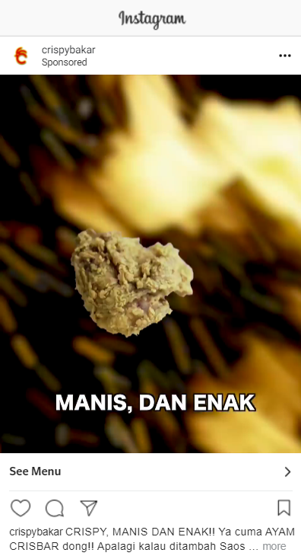
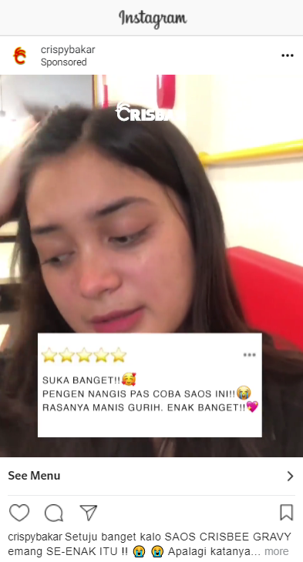
REENGAGEMENT CRISBEE CAMPAIGN
IG & FB CPR : Rp 424
Amount Spent : 179,692
Re-engagement 50% CPR : Rp 298
Amount Spent : 195,115
Re-engagement 75-90% CPR : Rp 281
Amount Spent : 190,642
IG & FB CPR : Rp 307
Amount Spent : 779,578
Re-engagement 50% CPR : Rp 305
Amount Spent : 960,672
Re-engagement 75-90% CPR : Rp 291
Amount Spent : 665,574
CRISBEE GARANSI
CRISBEE LUNET
SCORE : 19
RESULT : TAKE OUT ON AUGUST
SUGGEST : TIKTOK TUTORIAL CRISBEE
SCORE : 15
RESULT : STILL RUNNING ON AUGUST

Slide 6
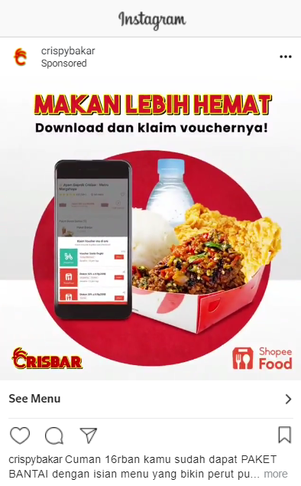
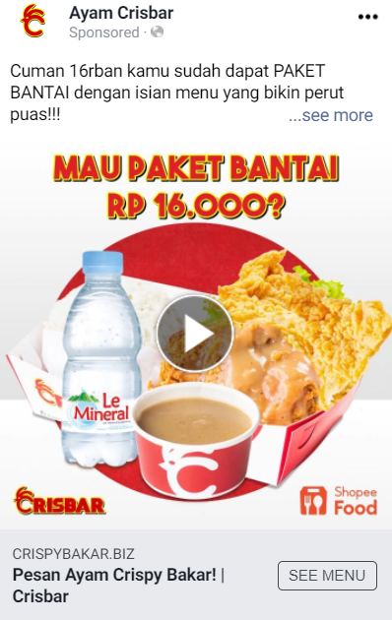
RETARGETING CRISBAR & CRISBEE CAMPAIGN
SHOPEEFOOD CRISBAR
SHOPEEFOOD CRISBEE
Database + Pixel CPR : Rp 518
Amount Spent : 1,483,046
Database + Pixel CPR : Rp 572
Amount Spent : 1,486,993
SCORE : 26
RESULT : STILL RUNNING ON AUGUST
SCORE : 27
RESULT : STILL RUNNING ON AUGUST

Slide 7
RESULT
Ads | Total Score
Angky crisbar | 5
Alwi Crisbar | 6
DKB Crisbee | 9
Crisbee Lunet (reengagement) | 15
ASMR Ivo | 16
Anime | 18
Tiktok tutorial Crisbar | 18
Crisbee Garansi | 19
Crisbee Lunet (prospecting) | 26
Shopee Food Crisbar | 26
Shopee Food Crisbee | 27

